Slide 1

Airline Twitter Analysis
By: Matthew Pascual-Mead

Slide 2
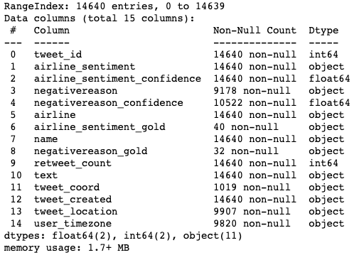
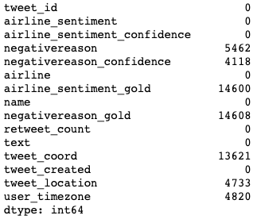
Data Cleaning
This dataset contains a total of 14,639 observations and 15 columns. The dataset information to the right shows that only 4 of the parameters are quantitative, with the remaining 11 being qualitative.
Knowing that this dataset was messy, I wanted to clean up some of the columns with missing values. Since the variables, “airline_sentiment_gold”, “negative reason_gold”, and “tweet_coord” were missing a very large amount of their values, I decided to remove them.

Slide 3
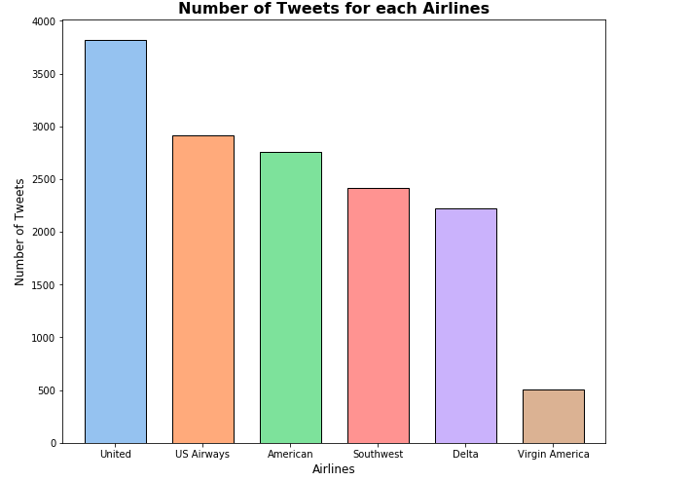
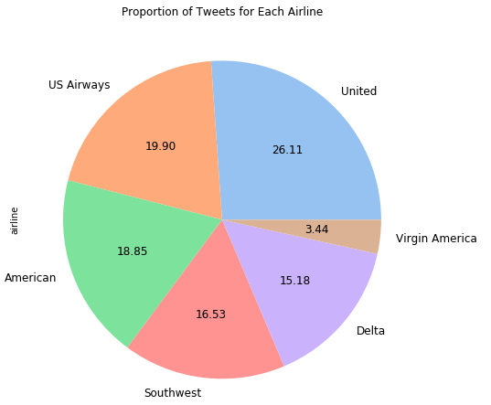
Total Airline Tweets
This dataset covers tweets for a total of six airlines: United US Airways American Southwest Delta Virgin America
Bar Plot: The bar plot shows the total number of tweets for each airline in this dataset. As we can see, the tweets for each airline are not distributed equally
Pie Chart: this pie chart exemplifies the proportion of tweets for each airline. United has the highest proportion of tweets at 26.11%. It is important to keep this imbalance in mind moving forward

Slide 4
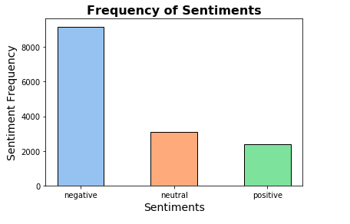
Frequency of Sentiments in Data
The sentiments of a tweet had 3 classifications: 1. Negative 2. Neutral 3. Positive
Since the primary objective of this dataset was to analyze the sentiment of tweets about airlines, I wanted to see what the frequency of sentiments was for all tweets about the airlines
The bar chart shows that the majority of tweets about airlines have a negative sentiment. This may indicate that people are influenced to tweet about airlines when they have a negative experience. With this in mind, more tweets for an airline might not be a great sign

Slide 5
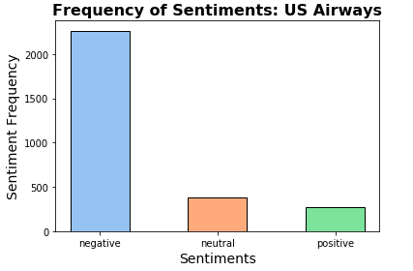
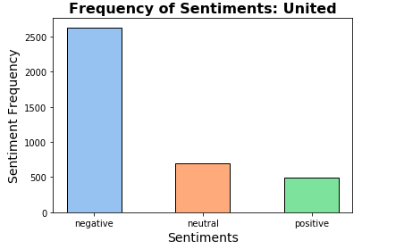

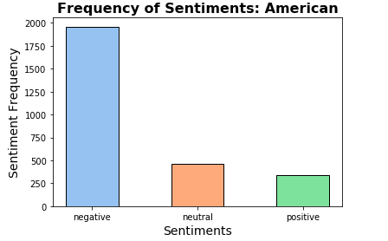

Frequency of Sentiments for each Airlines
These bar plots show the frequency of tweet sentiments for each airline, giving a better idea of their sentiments distribution
As shown, the airlines with the highest frequency of negative tweets were American, United, and US Airways.
However, as shown before, these airlines also had the highest overall tweet frequency. As a result, it is crucial to look at the proportion of the sentiments for each airline to better see how people feel about them on twitter.

Slide 6
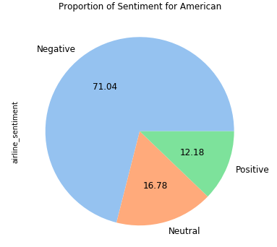
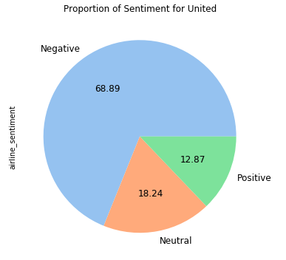
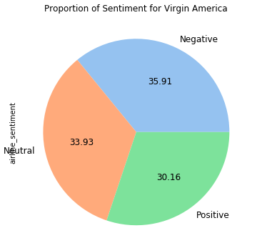
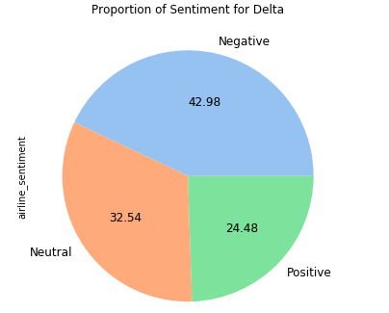
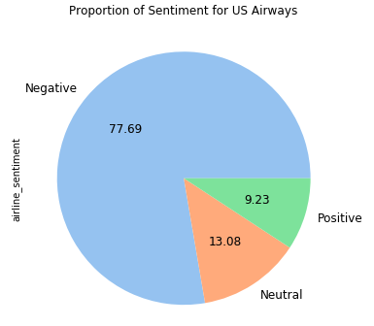
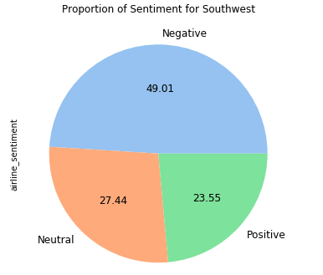
Proportion of Sentiments for each Airline
From the pie charts, it clearly shows that the percentage of tweets with a negative sentiment are still the highest among United, US Airway, and American!
On the contrary, the pie charts show that Delta, Virgin American, and Southwest have the lowest percentage of tweets with a negative sentiment

Slide 7
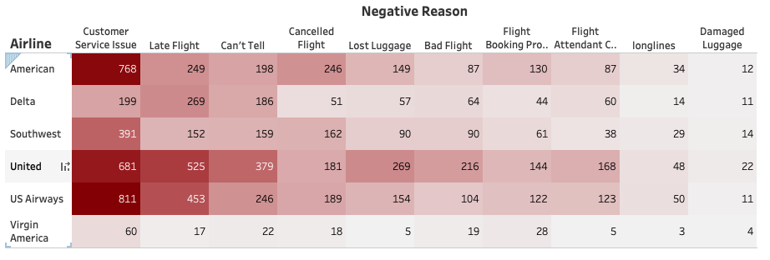
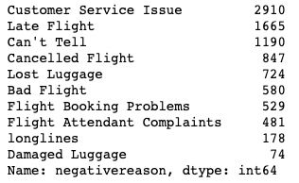
Negative Reasons of the Tweets
Diving deeper into the tweets with negative sentiments, we can see that the most common complaint in tweets about airlines is related to customer service issues.
As the heatmap shows, customer service is the number one area that needs improvement for all airlines, excluding Delta, according to tweets
Total Count of Negative Reason

Slide 8
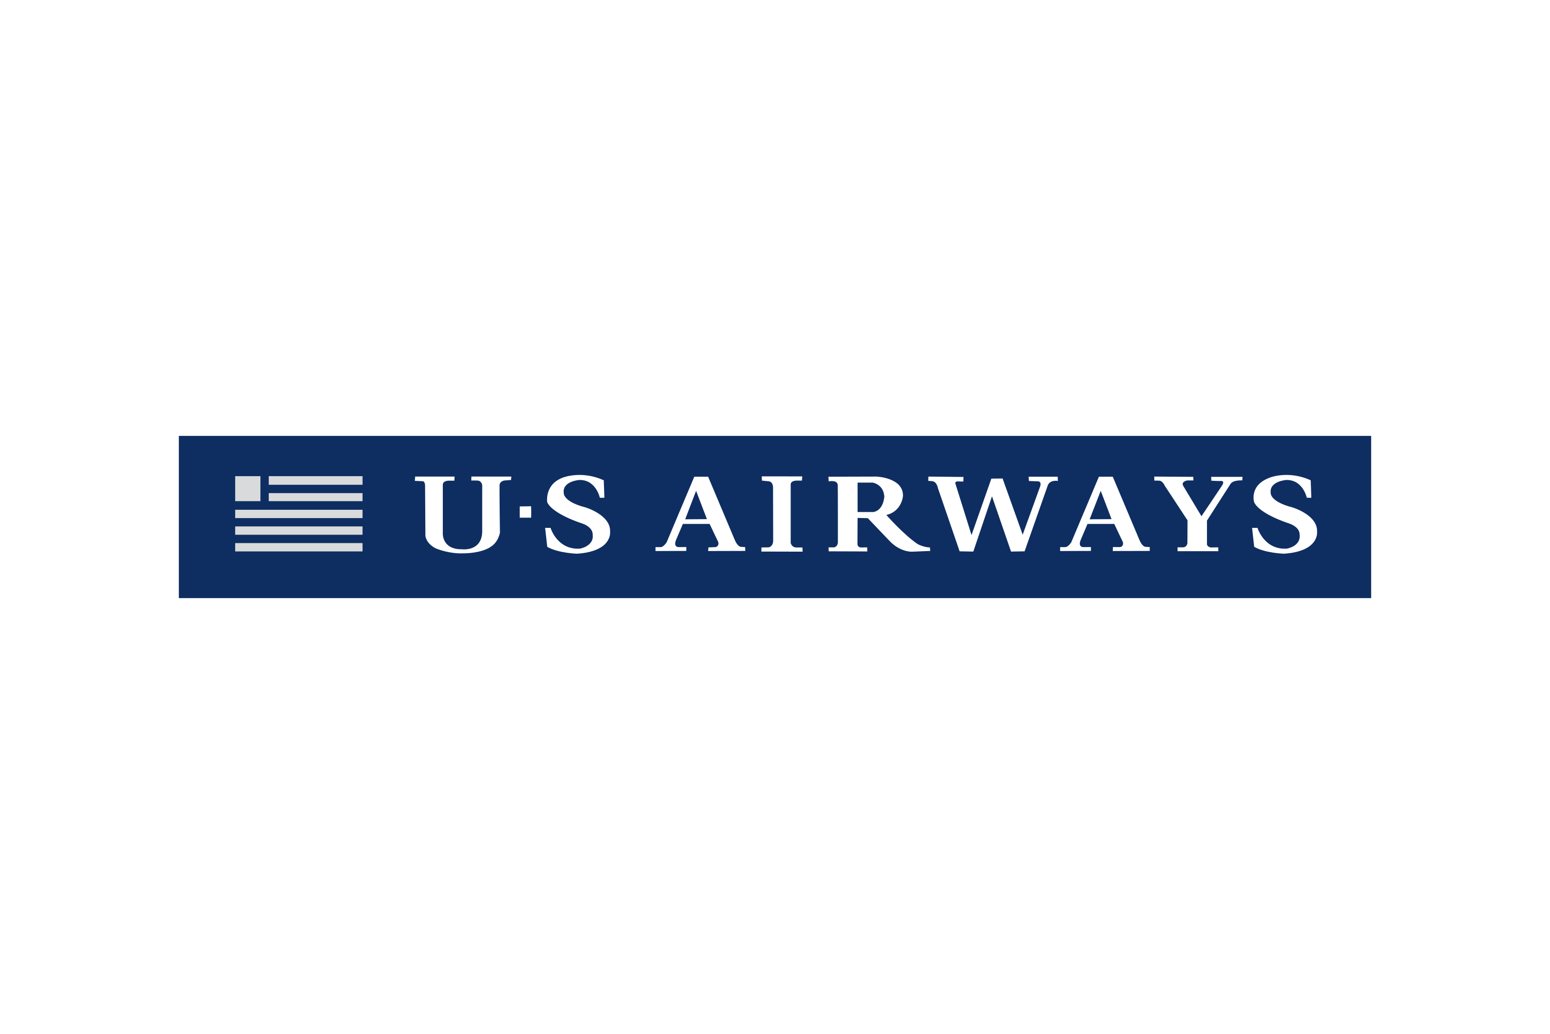

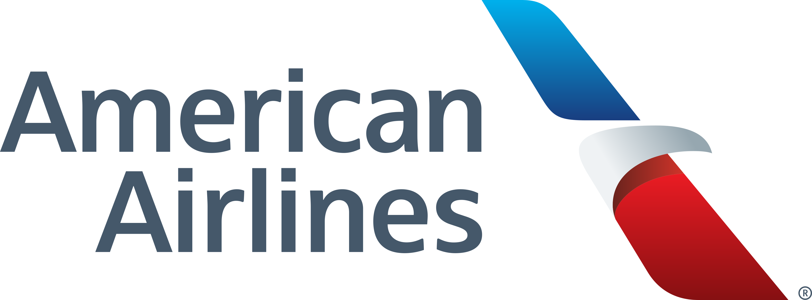

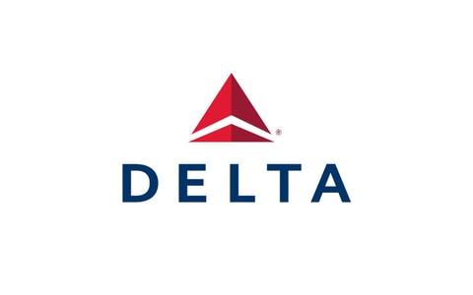

What I Learned
Through the analysis of this dataset, the airlines that are being tweeted about the most are not necessarily benefitting from it.
The three most tweeted about airlines in this dataset (United, US Airways, and American), not only had the highest frequency of tweets with a negative sentiment, but also had the highest proportion of tweets with a negative sentiment.
The other airlines (Southwest, Virgin American, and Delta) not only had fewer tweets about them, but they also had a better proportion of tweets with positive sentiment. Note: Virgin American had the lowest number of tweets, but the highest proportion of positive sentiment at 30.16%
Lastly, the leading reason for negative tweets about airlines, with the exception of Delta, is Customer Service Issues.

Slide 9
Moving Forward
Recommendations for Airlines
Future Project Objectives
United, US Airways, and American have a lot to work on within their organizations. I believe it would be beneficial if they were to dedicate more time to improving their customer service
Though, there are other negative reasons people are tweeting about them, reducing the amount of issues with customer service would be a great starting point for reducing the frequency and proportion of negative tweets
From this project, I was able to uncover some great insights that opened up potential for further analysis
In the future, I would love to explore the retweets variable to see if there was some sort of relationship with the number of retweets and sentiment.
I would also like to try and implement a predictive model to develop and test my machine learning skills further down the line

